Slide 1

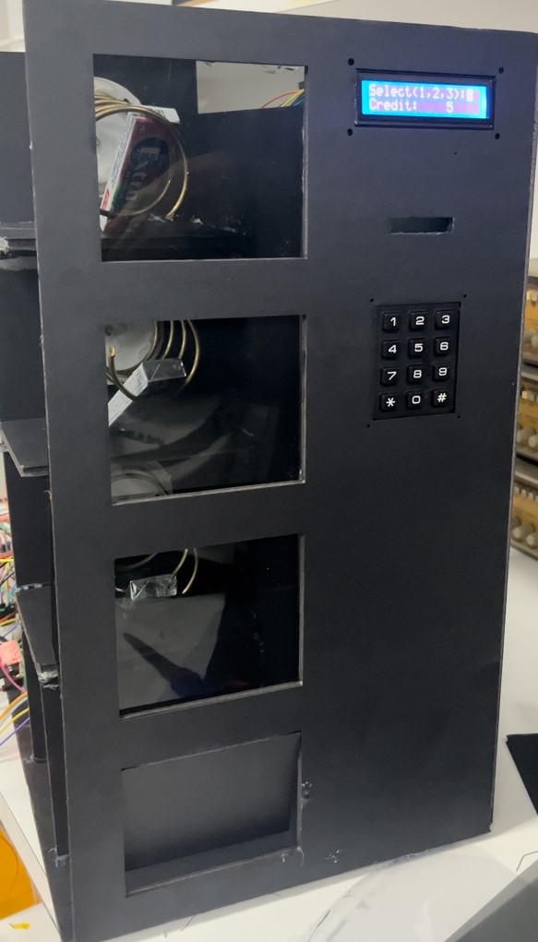
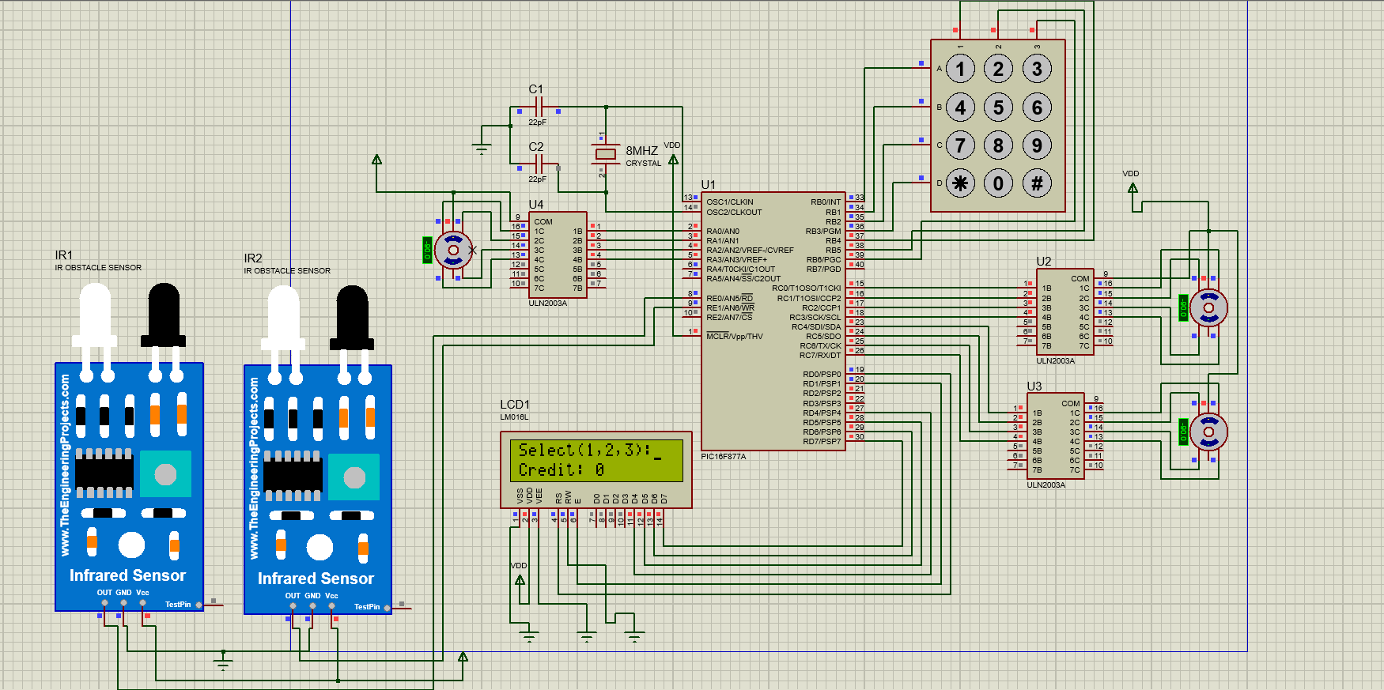
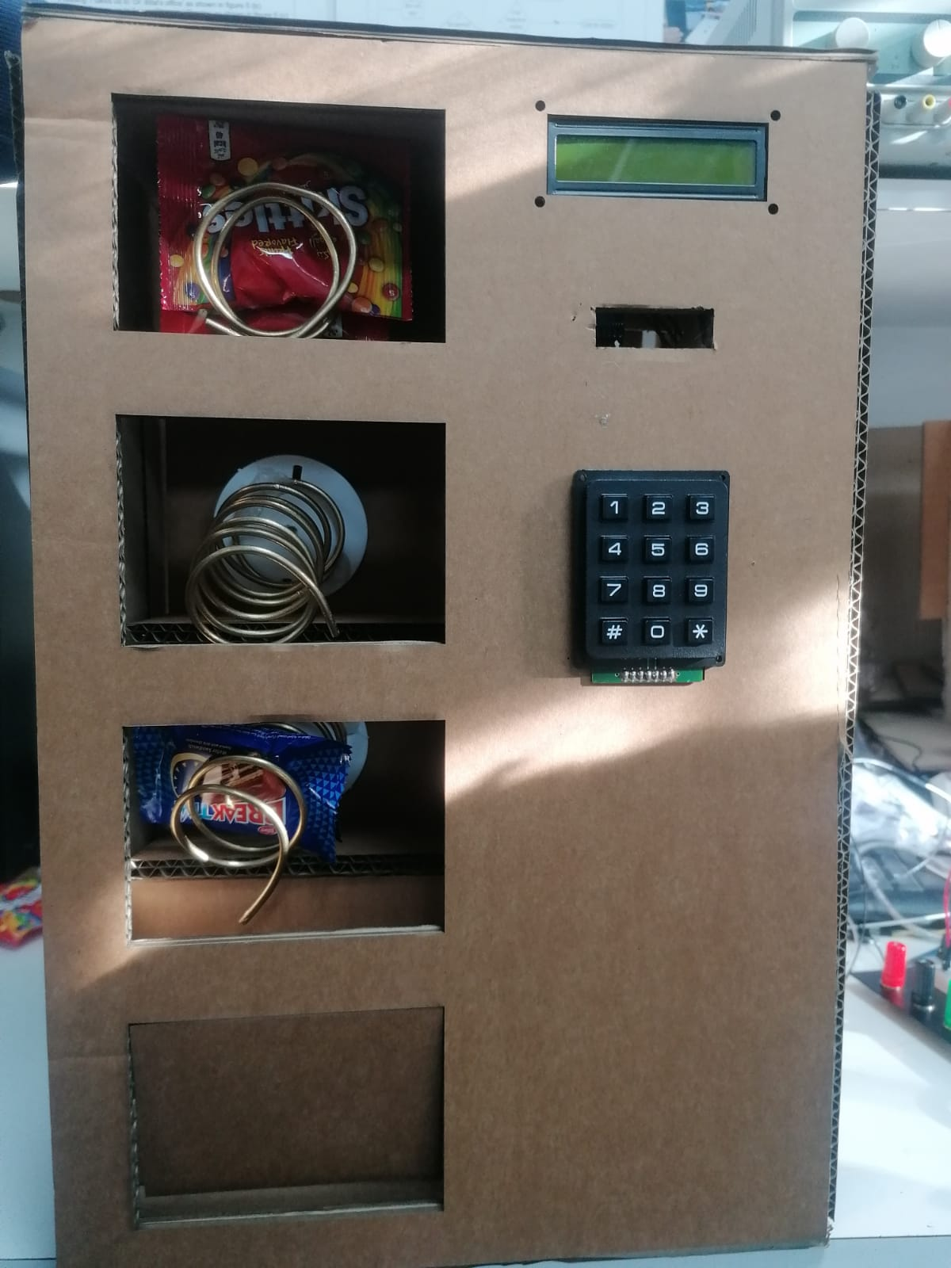
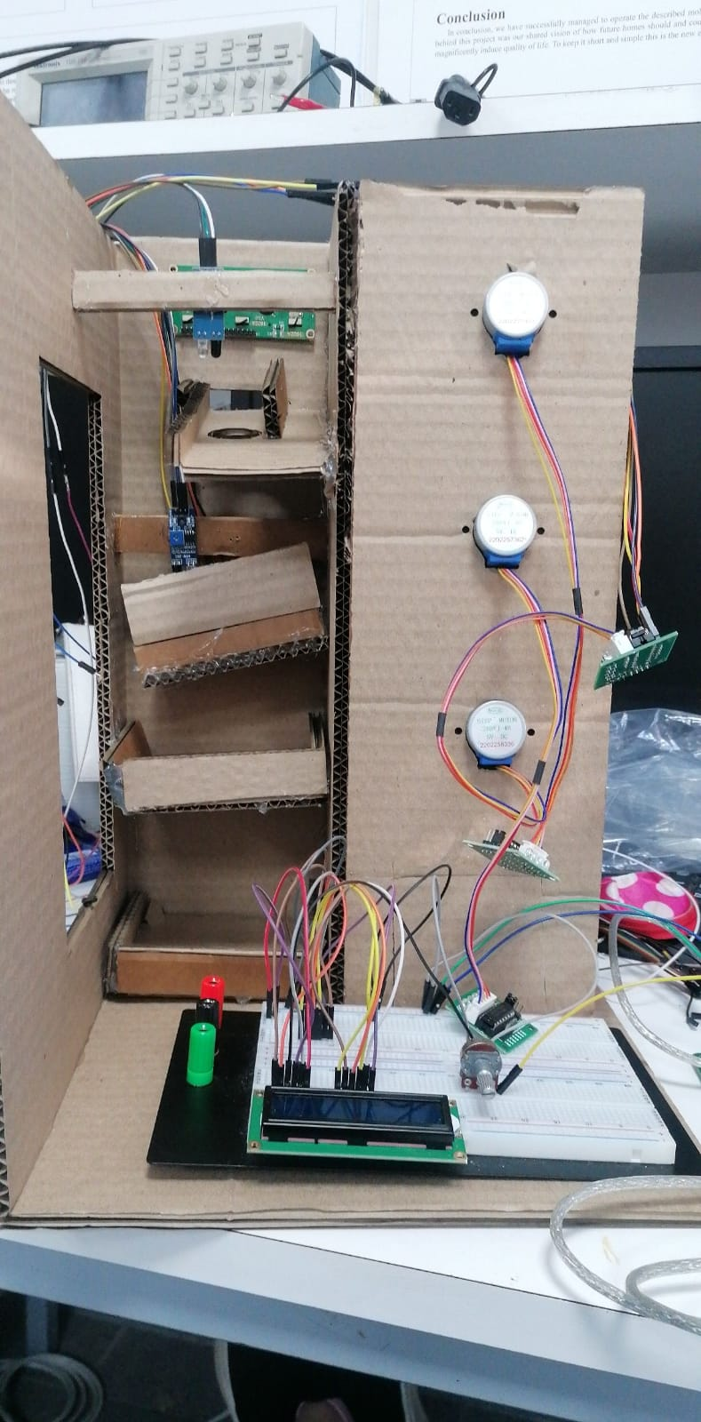
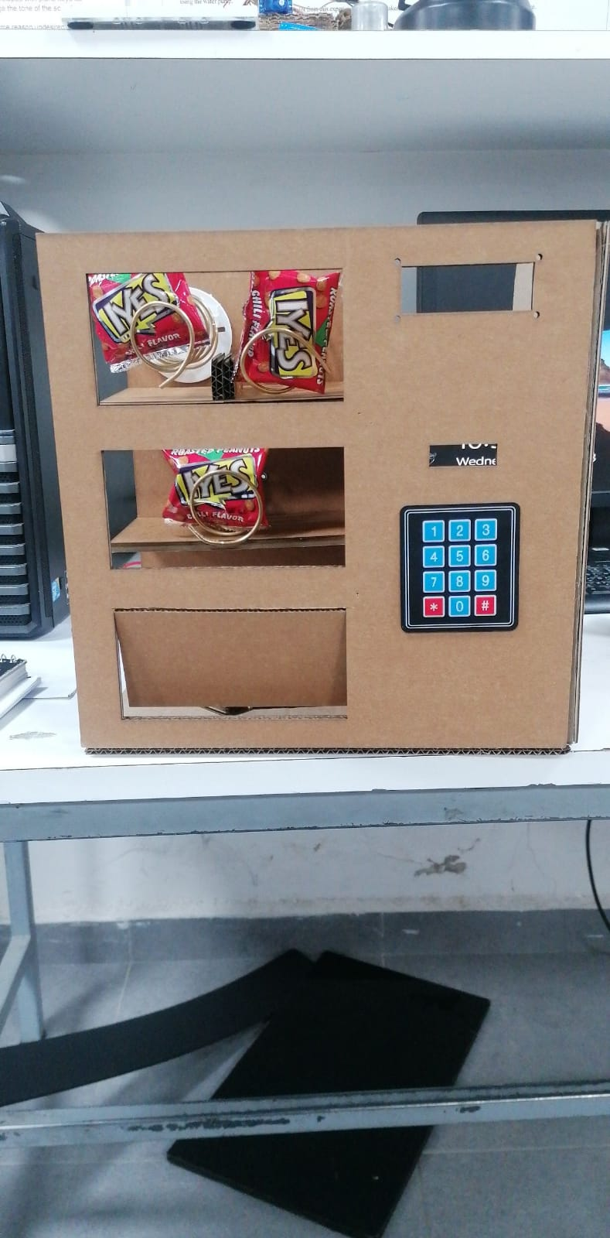
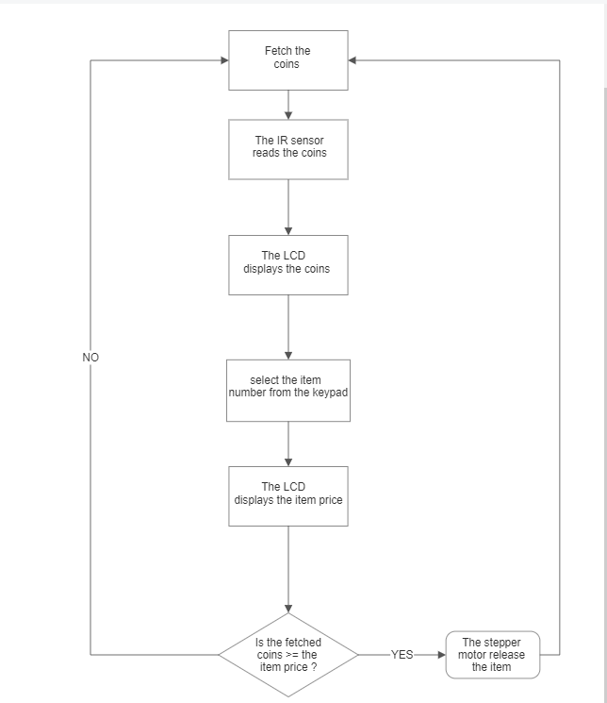
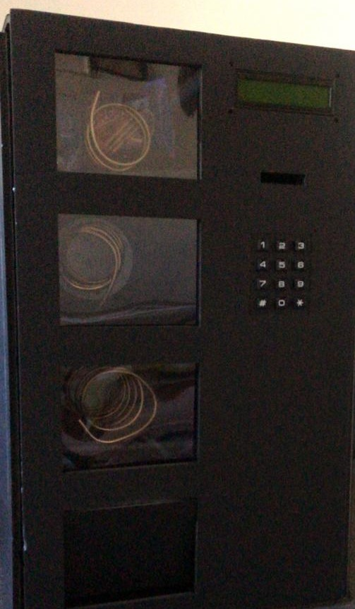
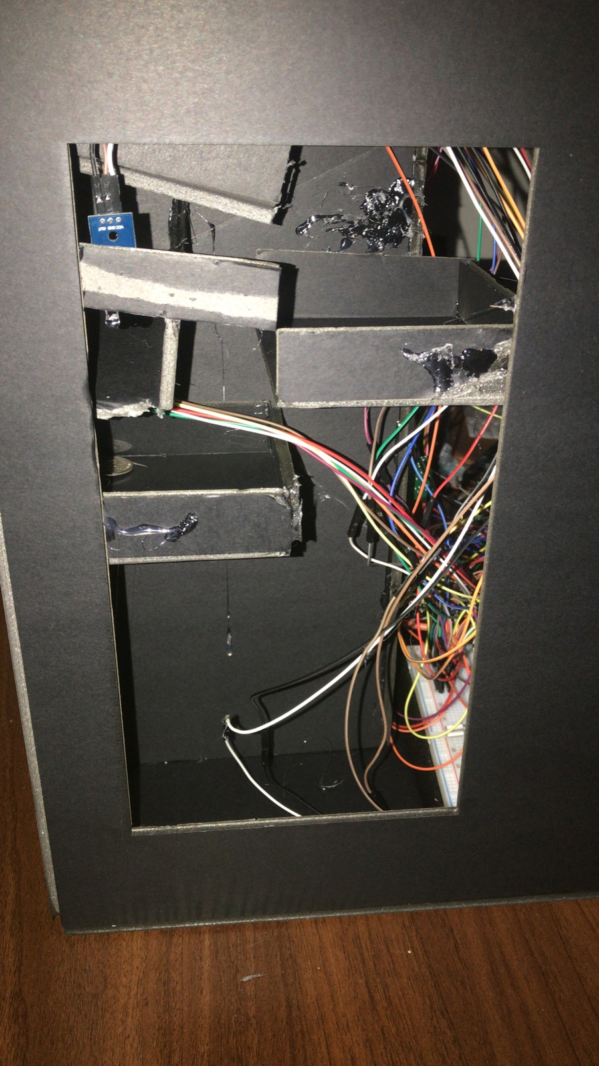
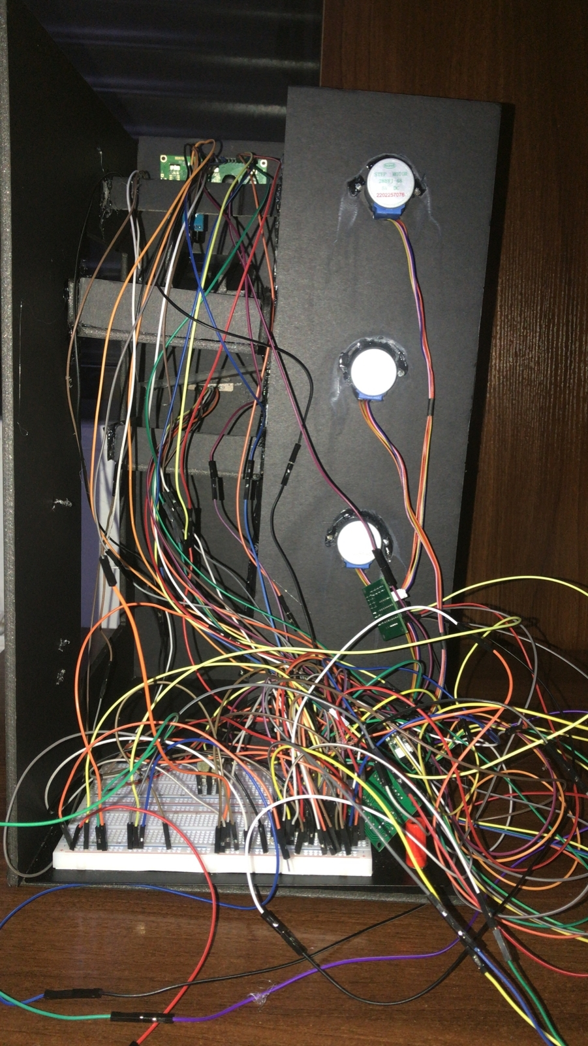
Vending machine
D.Hussein , T.Salameh, L. Abo Ghoush
Supervisor: Dr. Belal Sababha Embedded Systems Final Design Project, Fall 2022 King Abdullah II School of Engineering
Princess Sumaya University for Technology
Introduction
A vending machine that takes coins of two types (5,50 qirsh) in exchange for items each item is connected to a stepper motor that rotates to release the selected item. While 2 IR sensors are responsible for detecting the coins and count them. And a16x2 LCD is used to display the state of the machine during the process. Finally a 4x3 keypad is used to select the items. By pressing the number of the item on the keypad.
Results
Figure 3: vending machine (physical design)
Physical design last prototype (current vending machine)
Figure 5: second prototype (a), Motors and IR physical connection (b), first prototype (c).
We had to rebuild the prototype of the machine many times until it suites the requirements of our project components (the IR sensors and the stepper motors ..).
Figure 6: the vending machine
The process is as simple as this, just insert the coins into the machine, the IR sensors will display the credit that has been inserted into the machine on the LCD, that will also display the items numbers. Select the item using the keypad and wait until the stepper motor releases the item for you.
Design
Our design is quite simple. The wiring of the project was challenging since we have 3 stepper motors,LCD,2 IR sensors and a keypad, a total of (39) pins to be connected to the 16f877A MCU & Gnd/Vcc.
Figure 1: Proteus (hardware design)
As figure 1 shows the hardware connection that will be implemented on the breadboard after programming the code on the 16A877A pic and try it on the easypic board.
Figure 2: block diagram
(a)
(b)
(c)
Conclusion
Working with 16F877A pic is not easy as dealing with the Arduino, however dealing with the pic microcontroller is used for many applications and we needed to learn how to use it and how to deal with it in this embedded systems course.
By applying embedded system course principles, we managed to build a vending machine from scratch by using the 16F778A pic microcontroller, also we’ve used different types of motors and sensors and how to implement the code and the hardware design for each of them.

